Slide 1
BGU Real estate

Slide 2
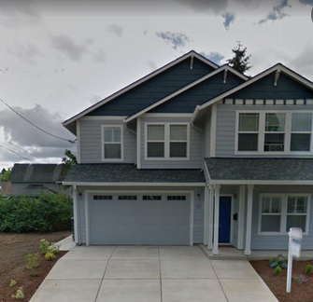
Process Overview - Part 1
[X1, X2, … , Xm]
Asset
image
Feature
extraction
New
asset
Concatenate
[X1, X2, … , X(m+n)]
[X1, X2, … Xn]
Meta
features

Slide 3
Process Overview - Part 2
Error regression
prediction
XGBoost
Regressor
[X1, X2, … , X(m+n)]
XGBoost
Classifier
Error range classification

Slide 4
Process Overview - Part 2
Fully connected Classifier
[X1, X2, … , X(m+n)]
Increase/ reduce / stay
With KBC’s prediction

Slide 5
Feature Extraction
For extracting features from the asset’s image we’ve used Efficientnet b7 (85% top-1 accuracy on ImageNet) with the ImageNet pretrained weights.
We Freeze the top layers and experiment with several stopping points.

Slide 6
Error regression prediction
Given an input that includes the concatenation of extracted features from the image and the meta features of the asset, we want to predict the error between KBC’s model prediction to the real price of the asset.
For that prediction we’ve used XGBoost regressor

Slide 7
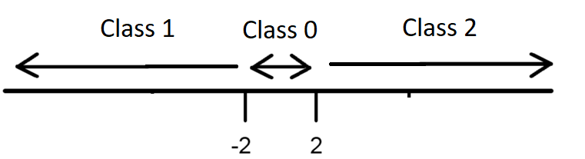
Error range classification
The approach we are using is – given a concatenated input, we want to classify if KBC’s prediction should increase, decrease or remain the same.

Slide 8
Initial results - Metrics
Improvement (%) | Improvement (Difference) | BGU | KBC | Metrics
1.84% | 172M | 9,160M | 9,332M | MSE

Slide 9

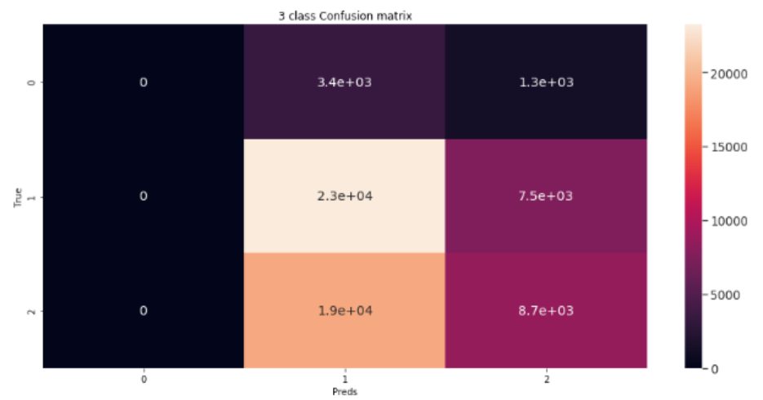
Initial results – Confusion Matrix + Accuracy score
BGU Prediction | True label | Class
0% | 7% | Keep KBC’s prediction
27.5% | 45% | Lower KBC’s prediction
72.5% | 48% | Increase KBC’s prediction
Accuracy score: 50.37%

Slide 10
Explainability
For explaining our model’s results we used 2 common tools:
Lime, SHAP

Slide 11
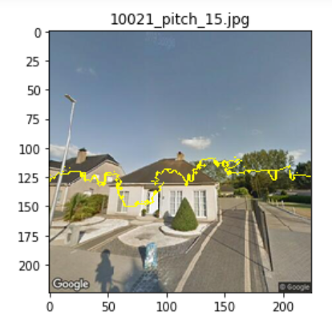
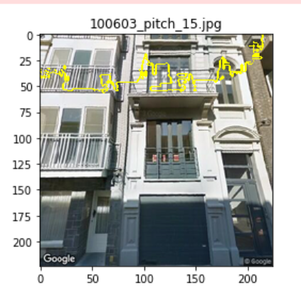
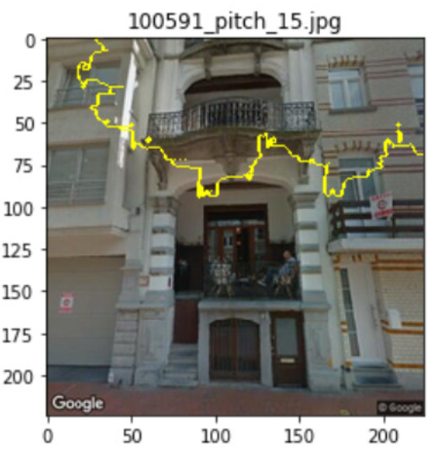
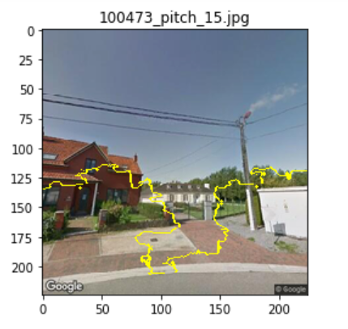
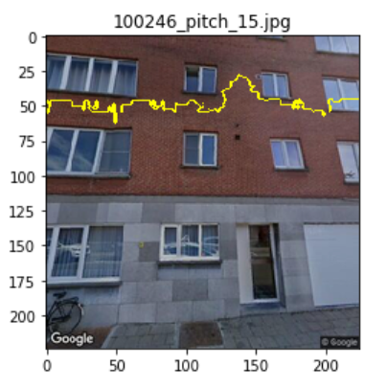
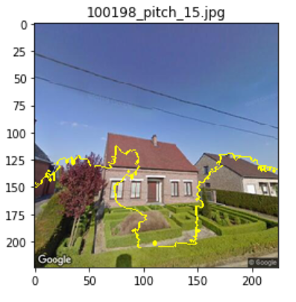
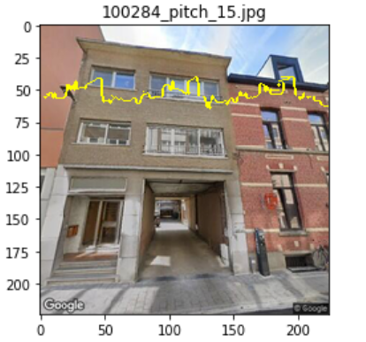
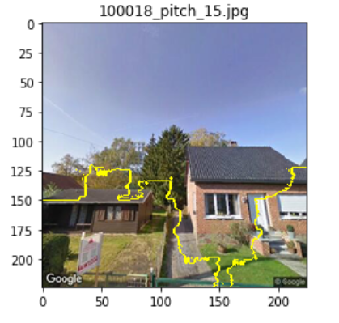
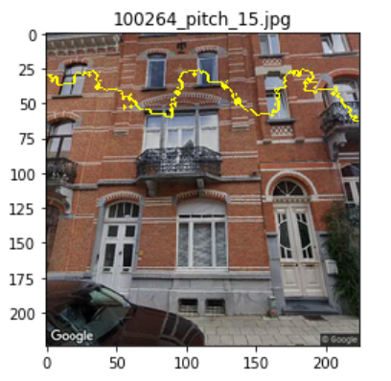
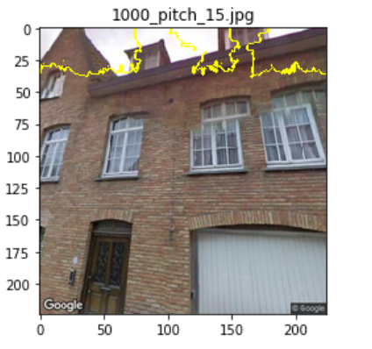
Lime
Given an input test image, Lime can mark on the image the parts the contribute to the model’s prediction.
Here are some examples:

Slide 12
SHAP
We’ve looked for the features that got high SHAP values when the prediction was correct. We found that one feature is sometimes active when our prediction was correct:

